Slide 1

Robotic Positioner
Add things here if needed
PRESENTED BY GROUP 5: Thomas Hu, Jordan Smith, Jason Wong

Slide 2
01
Overview
Problem Description
Requirements Analysis
System Alternatives
System Design
Q&A
TOPIC HIGHLIGHTS

Slide 3
PROBLEM DESCRIPTION
02

Slide 4
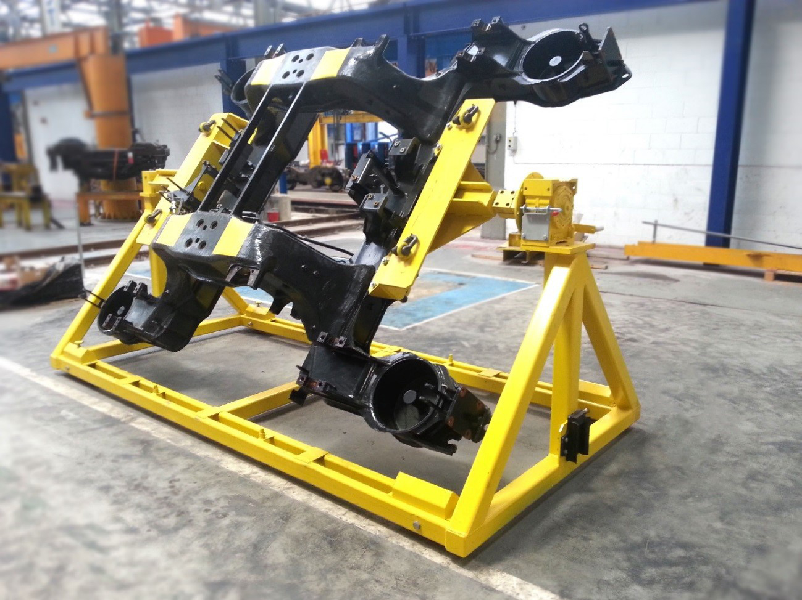
Problem Definition
A device which can be used to rotate equipment for welding, blasting, painting, or finishing that can be mounted to their existing rotator frames.
03

Slide 5
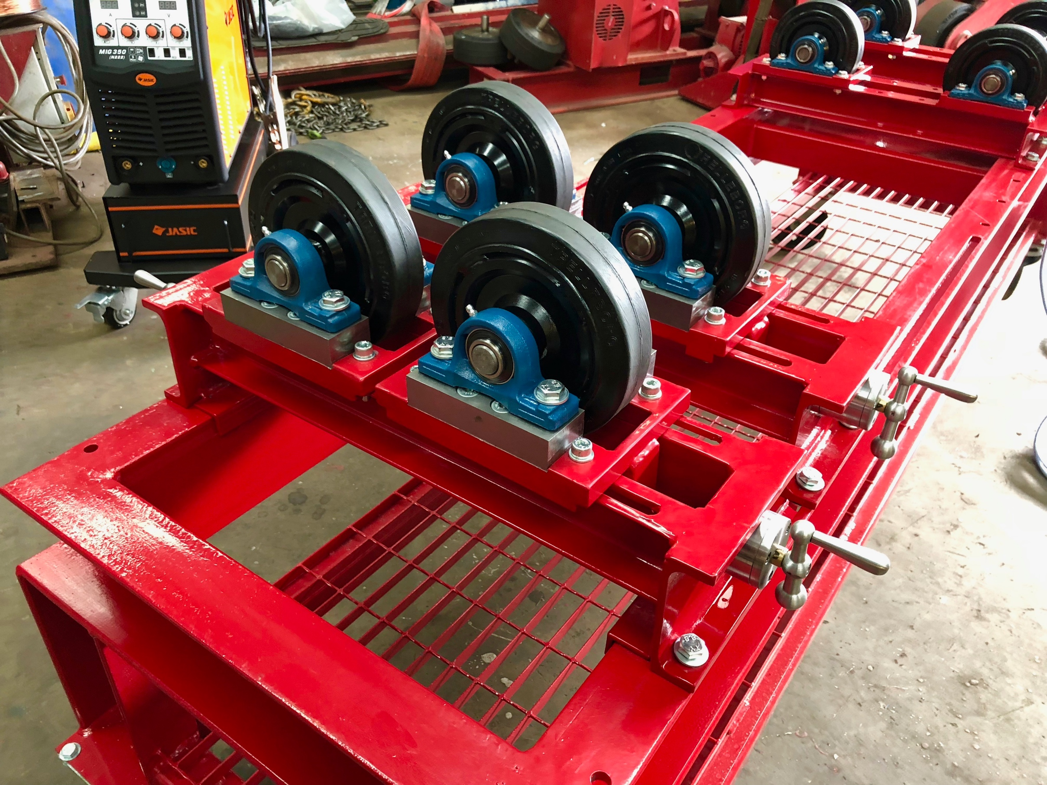
Why is this important?
04
Advancing mechanical machines forward with electronics.
Provides a safer environment for the users.
Improves efficiency.

Slide 6
Problem Statement
05
“There exists a need for a low cost system that can electrically rotate a load for welding applications to increase efficiency and safety.”

Slide 7
REQUIREMENTS ANALYSIS
06

Slide 8
5
Design Requirements
The system must rotate a load 360 around a horizontal axis.
Be able to recall and rotate to 4 different angle positions (physical buttons & E-stop).
Must be able to support up to max load of 500 kilograms (kg).
The speed of the rotations must be 1-5 rpm.
The system shall be built using two “A” frame supports provided by the client.
Total cost of the system components must not exceed $10,000 Canadian Dollars.
All components used are RoHS compliant.

Slide 9
SYSTEM ALTERNATIVES
02

Slide 10
Microcontroller Alternatives
09
Requirement | Weight | Arduino Uno | Teensy 3.6 | TI Launchpad
Power | 5.00% | 2 | 1 | 3
Cost | 20.00% | 3 | 2 | 3
No. GPIO | 25.00% | 2 | 3 | 1
Reliability/Support | 15.00% | 3 | 2 | 2
Memory Size | 15.00% | 2 | 3 | 2
Compatibility | 20.00% | 3 | 2 | 2
TOTAL | 100.00% | 2.55 | 2.35 | 2

Slide 11
Motor Alternatives
09
Induction Motor
Stepper Motor
Inexpensive
Easy to maintain
Speed control is very limited and expensive via variable frequency drive
High in rush current when heavy loaded
Requires external positioning sensors
High torque at lower speeds
Relatively simple operation
Possible to operate in closed loop feedback, eliminating external sensor
Sudden drop off in torque as speeds increase
Noisy
Requires external driver

Slide 12
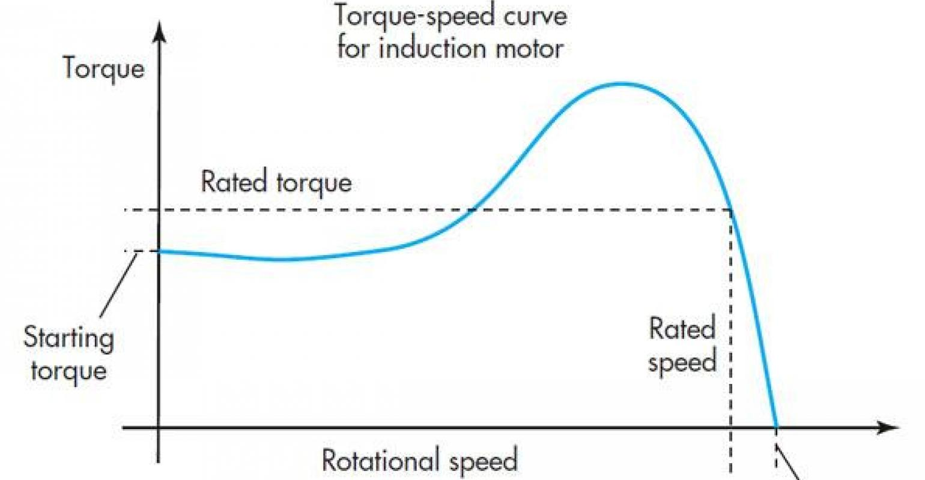
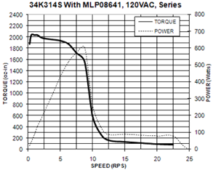
Motor Alternatives Continued
09
Induction Motor
Stepper Motor

Slide 13
Encoder Alternatives
09
APPROACH
STRATEGY
TEAM
Presentations are tools that can be used as lectures.
Presentations are tools that can be used as lectures.
Presentations are tools that can be used as lectures.

Slide 14
Gearbox Alternatives
09
APPROACH
STRATEGY
TEAM
Presentations are tools that can be used as lectures.
Presentations are tools that can be used as lectures.
Presentations are tools that can be used as lectures.

Slide 15
SYSTEM DESIGN
02

Slide 16
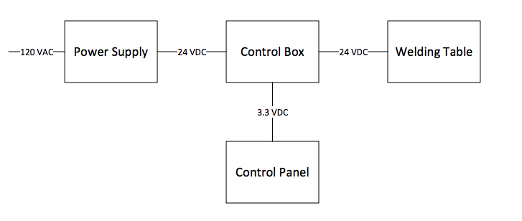
Hardware Design
04
System-Level Block Design

Slide 17
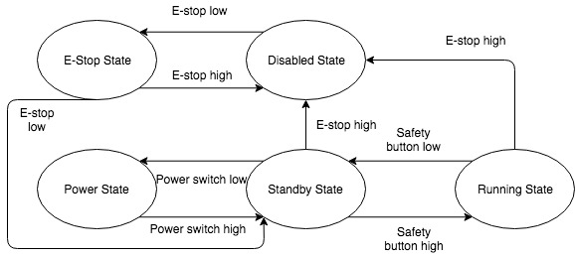
Software Design
04
System-Level Block Design

Slide 18
MICROCONTROLLER
MOTOR
A compact integrated circuit designed to operate the motor.
Rotates the gearbox to do something
ENCODER
GEARBOX
A motor mounted encoder provides closed loop feedback signals to communicate the speed and position of the motor shaft.
A mechanical drive to step down the speed of rotation from the motor shaft to the output drive, proportionally increasing the torque.
10
Subsystems

Slide 19
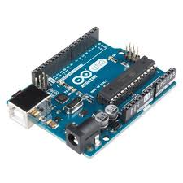
Microcontroller
Handles multiple digital and analog I/O.
Store and analyze data for a motor.
Calibrate a certain rotational angle.
Store a specific position.
Simple for users and client to maintain.
07

Slide 20
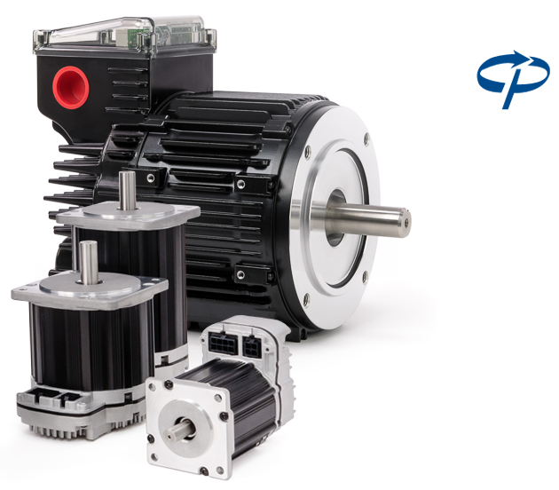
Servo Motor
Closed loop feedback operation.
Near constant torque within operational speeds.
Integrated encoder for high precision position tracking.
07

Slide 21
Gearbox
Presentations are tools that can be used as lectures.
07
IOS APP MADE FOR CLIENT, FITNESS PALS

Slide 22
Encoder
Presentations are tools that can be used as lectures.
07
IOS APP MADE FOR CLIENT, FITNESS PALS

Slide 23
Q&A
02

Slide 24
100%
CLIENT SURVEY
CLIENT SATISFACTION FOR 2020
04
Presentations are tools that can be used as lectures.

Slide 25
05
INTRODUCE NEW SERVICES
Presentations are tools that can be used as lectures.
EXPAND TO NEW TERRITORIES
Presentations are tools that can be used as lectures.
RETAIN SATISFIED CLIENTS
Constraints
Presentations are tools that can be used as lectures.

Slide 26

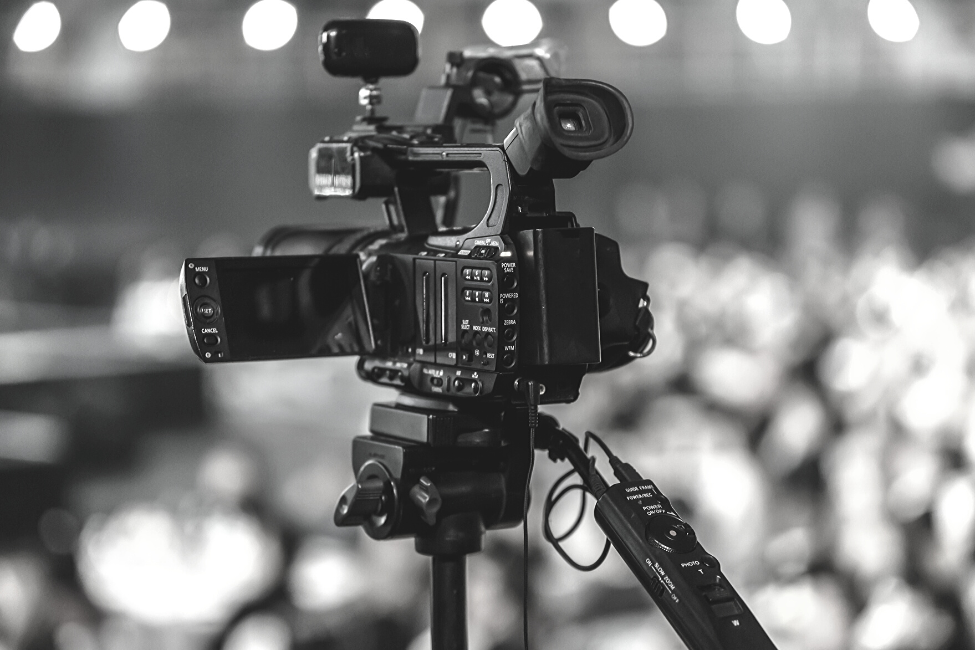

06
APP PRODUCTION AND MARKETING
FULL VIDEO AD PRODUCTION
PR AND CRISIS MANAGEMENT
Presentations are tools that can be used as lectures.
Presentations are tools that can be used as lectures.
Presentations are tools that can be used as lectures.

Slide 27

CALORIE COUNTER APP
Presentations are tools that can be used as lectures.
07
IOS APP MADE FOR CLIENT, FITNESS PALS

Slide 28

30-second YouTube ad for client, Puppy Nation
Presentations are tools that can be used as lectures.
08

Slide 29
PR AND CRISIS MANAGEMENT
09
APPROACH
STRATEGY
TEAM
Presentations are tools that can be used as lectures.
Presentations are tools that can be used as lectures.
Presentations are tools that can be used as lectures.

Slide 30
SOUTHEAST ASIA
AUSTRALIA
Presentations are tools that can be used as lectures and more.
Presentations are tools that can be used as lectures and more.
MIDDLE EAST
EUROPE
Presentations are tools that can be used as lectures and more.
Presentations are tools that can be used as lectures and more.
10
Newly serviced territories

Slide 31




11
CLIENTS IN 2020
Alpine
Fresh Milk
Organix Cookies
Zyrcone Teleservices
Rubix
Motors

Slide 32
8.50%
15%
REVENUE GROWTH IN 2019
SALES OF CRIME AND MYSTERY NOVELS
12

Slide 33

13
COMPANY PERFORMANCE ANALYSIS IN 2019
Presentations are tools that can be used as lectures and more.
COMPANY PERFORMANCE ANALYSIS IN 2020
Presentations are tools that can be used as lectures and more.

Slide 34
14
MAJOR REVENUE SOURCES IN 2020
Item 5
20%
Item 1
20%
Item 5
20%
Item 1
20%
Item 5
20%
Item 1
20%
Item 4
20%
Item 2
20%
Item 4
20%
Item 2
20%
Item 4
20%
Item 2
20%
Item 3
20%
Item 3
20%
Item 3
20%
TRADITIONAL ADVERTISING
SOCIAL MEDIA ADVERTISING
CLIENT SERVICING

Slide 35

Presentations are tools that can be used as lectures.
15

Slide 36
16
QUARTERLY GROWTH IN 2020
40
30
20
10
Graphs and charts are visual aids that help add more context.
0
Item 1
Item 2
Item 3
Item 4
Item 5

Slide 37
MONTHLY GROWTH HIGHLIGHTS IN 2020
JANUARY
Presentations are tools that can be used as lectures.
MARCH
Presentations are tools that can be used as lectures.
APRIL
Presentations are tools that can be used as lectures.
17

Slide 38
REVENUE ALLOCATION
IN 2020
60
40
20
0
Item 1
Item 2
Item 3
Item 4
Item 5
Item 6
18
Graphs and charts are visual aids that help add more context.

Slide 39
19
BALANCE
INCOME
Presentations are tools that can be used as lectures.
Presentations are tools that can be used as lectures.
CASH FLOWS
SHAREHOLDERS
Presentations are tools that can be used as lectures.
Presentations are tools that can be used as lectures.
Financial Statements 2020

Slide 40


ACTIONABLE ITEMS
22
Q1 2021
Q2-Q3 2021
Q4 2021
WIDEN SERVICE PORTFOLIO
ADD COMPANY CERTIFICATION
PURCHASE LICENSES

Slide 41



THE FINANCE TEAM
LILA DAWSON
JASON MULLER
GRACE CUDDINGTON
Senior Finance Manager
Public Accountant
23
Legal Head

Slide 42
MAILING ADDRESS
123 Anywhere Street, Any City
GET IN TOUCH WITH FINANCE
PHONE NUMBER
24
123-456-7890
EMAIL ADDRESS
hello@reallygreatsite.com

